Slide 1
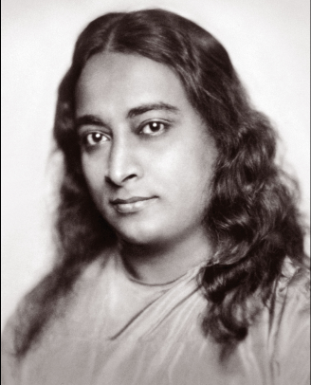
Paramahansa Yogananda
And The Self-Realization Fellowship
By Shawn Nelson, Nov. 2018

Slide 2
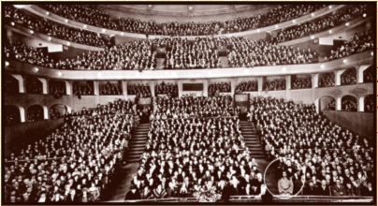
Paramahansa Yogananda
Birth name is Mukunda Lal Ghosh.
Born near Himalayan Mountains in India, 1893. Died in 1952 as missionary in United States.
Became Hindu guru under Yukteswar Giri (1828-1895).
Invited to USA by Unitarian Church in 1920 to preach unity of all religions.
Had ability to captivate people with his charisma.
Packed auditoriums to capacity.

Slide 3
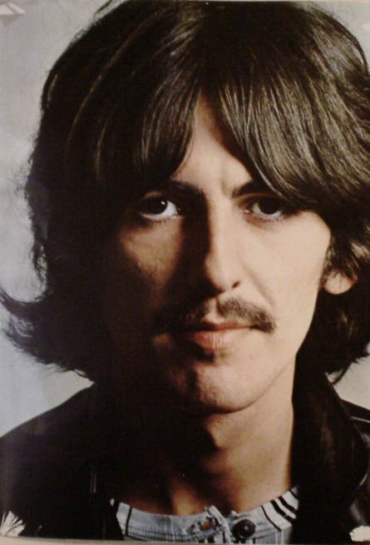
Impact on USA
“[I] just looked at the cover, and he just zapped me with his eyes… If I hadn't read that, I probably wouldn't have a life… I'd just be, you know, some horrible person with a pointless life. It just gave meaning to life…”
“The Autobiography of a Yogi is the book that I keep stacks of around the house. And I give it out constantly, you know, to people. You know, like when people need regrooving. Read this.”
George Harrison
The Beatles

Slide 4
Impact on USA
All four SRF gurus are featured on the popular Beatles album Sgt. Pepper's Lonely Hearts Club Band (1967)
These were considered the most significant people top shape modern US culture.
Yukteswar Giri
Paramahansa
Yogananda
Babaji
Lahiri Mahasaya

Slide 5
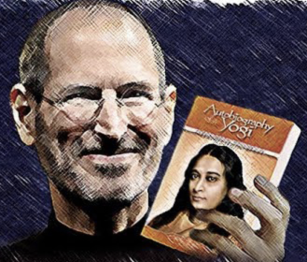
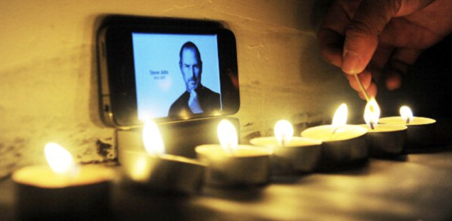
Impact on USA
“Steve Jobs apparently had only one book on his iPad. Lo and behold, that book turns out to be the Autobiography of a Yogi.”
Steve prearranged to give every attendee a copy of Autobiography of a Yogi at his memorial.

Slide 6
Impact on USA
Today yoga and meditation are now household words
Taught in community centers, public schools, business seminars, malls.

Slide 7
Paramahansa’s Teaching
Yogananda said he was revealing true Christianity to the West.
But what Yogananda brought was really Hinduism
Repackaged using Christian words.

Slide 8
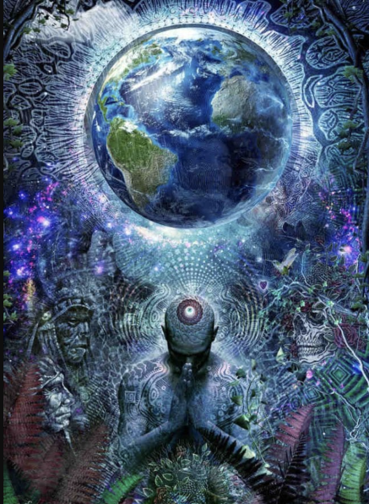
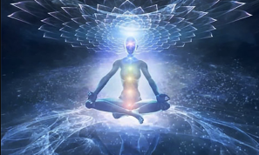
God
Yogananda Taught:
Pantheism: God is all and all is God
Everything, including people, and even the matter of the universe (atoms), is divine.
He wrote, “Every grain of food you eat, every breath you take, is God.” (Scientific Healing Affirmations, K882)

Slide 9
Creation
Yogananda Taught:
The entire universe is an illusion (maya)
God (Spirit) individualized itself through “vibratory activity” to create this world much like the rays of light from a projector are individualized onto a movie screen.
Pure Spirit created a universe in which it divided itself “into many souls that they may play with Me.” (Journey to Self-Realization, 32)
Just like a movie is not real, so creation is also not real.

Slide 10
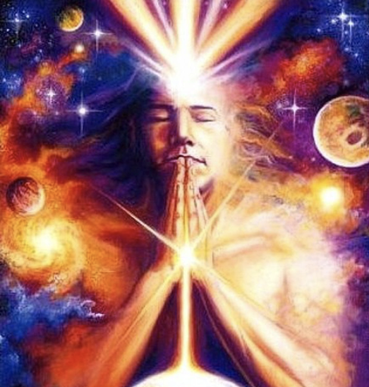
Man
Yogananda Taught:
Man is also an illusion.
Man’s true essence is divine.
Goal is for people is to recognize that their true nature is divine and that they are actually one with God.
This is called “self-realization.”
The Lotus Flowers around the Encinitas complex are illustrations of man realizing this divinity within.

Slide 11
Sin & Evil
Yogananda Taught:
There is no sin; our problem is we’re ignorant of our true nature: divinity.
Ignorance is “the root-cause of all human maladies.” (The Yoga of Jesus, K630)
We’re merely duped into thinking everything is real, including our pain.
However, “When we have finished seeing the motion picture, we know that nobody was killed; nobody was suffering.” (Journey to Self-Realization, 20)
There is really then no evil, no disease, no disharmony, no separateness.
Even Satan himself is an illusion (he is taught to be symbolic). Hell does not exist.

Slide 12
Karma & Reincarnation
Yogananda Taught:
Illusion (maya) keeps people trapped in a near-endless cycle of rebirth.
Man is travelling a path of upward evolution played out over many lives.
Actions from previous lives affect subsequent ones. This is the law of karma.
Yogananda said people work out karma through “many lifetimes of physical, mental, and spiritual evolution.” (The Yoga of Jesus, K929). Only then can we break the cycle of rebirth.

Slide 13
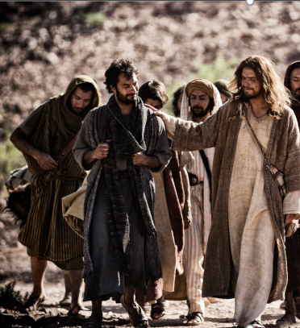
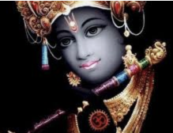
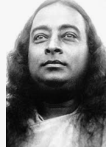
Jesus
Yogananda Taught:
Jesus was an ordinary man who attained “Christ Consciousness.”
Jesus was just one of many sent to help mankind throughout history (there were many others including Krishna, Buddha, Yogananda and his gurus).
Jesus did not die on the cross to provide salvation for our sins, but to be an example for us and show us the way to self-realization.

Slide 14
Salvation
Yogananda Taught:
Self-realization (not forgiveness) is what we need.
Our problem is ignorance of our divinity.
We must follow the example of Jesus and become like Christ, resurrect the Christ within us, and attain “Christ Consciousness” for ourselves.
The “second coming” of Jesus will be when the masses finally achieve this.

Slide 15
More Info
More About Paramahansa Yogananda:
See the paper this presentation is based on titled “Paramahansa Yogananda and the Self-Realization Fellowship” by Shawn Nelson, November 2018.
Christian Responses:
Summary: Dean Halverson, ed., The Compact Guide to World Religions (Minneapolis, Minn.: Bethany House Publishers, 1996).
Defense: Chapter 6 (The New Age Movement) and chapter 8 (Hindu-Based Cults) in Ron Rhodes, The Challenge of the Cults and New Religions (Grand Rapids, MI: Zondervan, 2001).
More detailed and academic: See Douglas R. Groothuis, Jesus in an Age of Controversy (Eugene, OR: Wipf & Stock Pub, 2002).
Defense against New Age: J. Yutaka Amano and Norman L. Geisler, The Infiltration of the New Age (Wheaton, Ill.: Tyndale House Pub, 1989).

