Slide 1
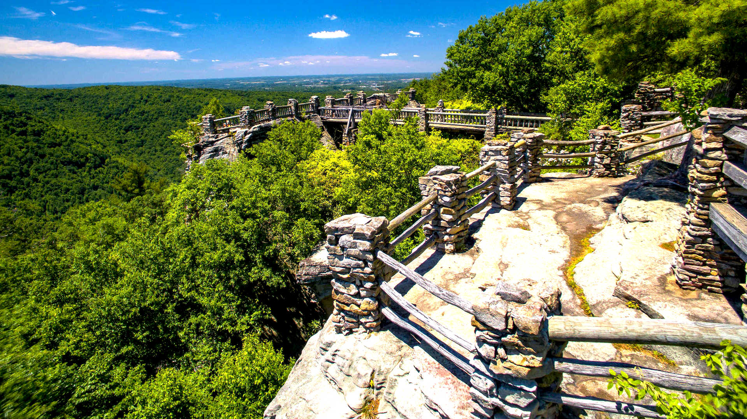
Important Safety Rails
in the Creation Debate
By Shawn Nelson, Dec. 2018

Slide 2
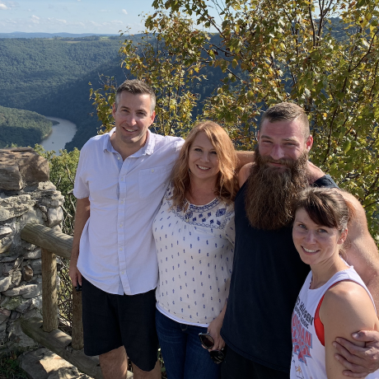
Coopers Rock, West Virginia
High above the Cheat River in West Virginia.
Overlook far and wide of the unspoiled Appalachian Mountains.
Visitors free to move around but must stay inside the safety rails.
Otherwise, they risk serious injury, possibly plummeting to death!

Slide 3
Big Idea
There’s freedom to move within this debate.
But like Coopers Rock, it is an area not without safety rails.
Serious theological dangers face all who climb over these rails.
!

Slide 4
Outline
Explain the 3 major views.
Give 7 safety rails.
Evaluate of how each view lines up to these rails.

Slide 5
Young Earth View (A)
God created the entire universe in six 24-hour days about 6,000 years ago.
Life was created in “kinds” or distinct, fully-functional lifeforms.
Adam and Eve were the first human kind.
No physical death before the Fall.
Genesis 1-11 real historical events, with real people in real places.
Flood / catastrophism best explains fossil evidence.
Claims to be the most faithful to Scripture.
Sees any other interpretation of “day” besides a “literal” one is an attack on Scripture.

Slide 6
Old Earth, Non-Evolution View (B)
Like (A) says Genesis 1-11 are real events with real places and people.
Like (A) believes life was created in distinct kinds (it did not evolve).
Unlike (A) but like (C) they agree with majority of scientists that universe is 13.8 billion years old (earth 4.5 billion years old).
Sees other ways to understand days of Genesis while still honoring the Bible:
View | Creative Acts | Note
(1) Day-Age View | Long Periods | Creation "days" are long ages.
(2) Revelatory-Day View | Long Periods | God revealed creation events to Moses over six 24hr days.
(3) Literary-Framework View | Long Periods | Like (1) but biblical events not in sequential order.
(4) Alternate-Day-Age View | 24-Hour Windows | God created in 24-hour windows between long ages.
(5) Gap Theories | Six 24-hour days | Long period of time before God began creating in 24hr days.
(6) Ideal-Time View | Six 24-hour days | God created universe with appearance of age.
(7) 24-Hour Day View* | Six 24-hour days | All events were finished in 6 normal 24-hour days.
* Included for comparison.

Slide 7
Old Earth, Theistic Evolution View (C)
Like (B) they believe the universe is 13.8 billion years old and the earth is 4.5 billion years old.
But unlike (A) & (B) they God did not create life in distinct, fully-functioning forms.
In other words, they believe evolution happened.
But does affirm that God guided evolution (hence theistic evolution).

Slide 8
Outline
Explain the 3 major views.
Give 7 safety rails.
Evaluate how each view lines up to these rails.

Slide 9
Important Safety Rails
in the Creation Debate
It’s important to:
1. Recognize the need for charity.

Slide 10
Rail 1: The Need for Charity
Difference between primary and secondary doctrines (discuss some).
We will have serious challenges if we cannot get along with Christians in church who have different views from us (wait for charts on next slides).
There’s a biblical mandate and reasonable need for grace/charity in areas of disagreement (Rom. 14).

Slide 11
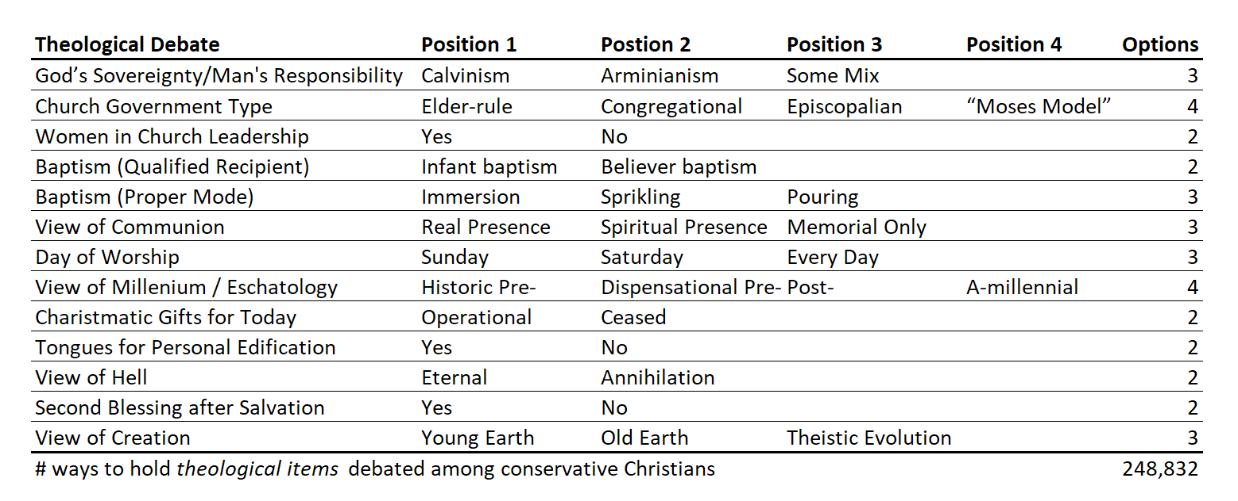
So many ways to disagree in a typical conservative Christian church!

Slide 12
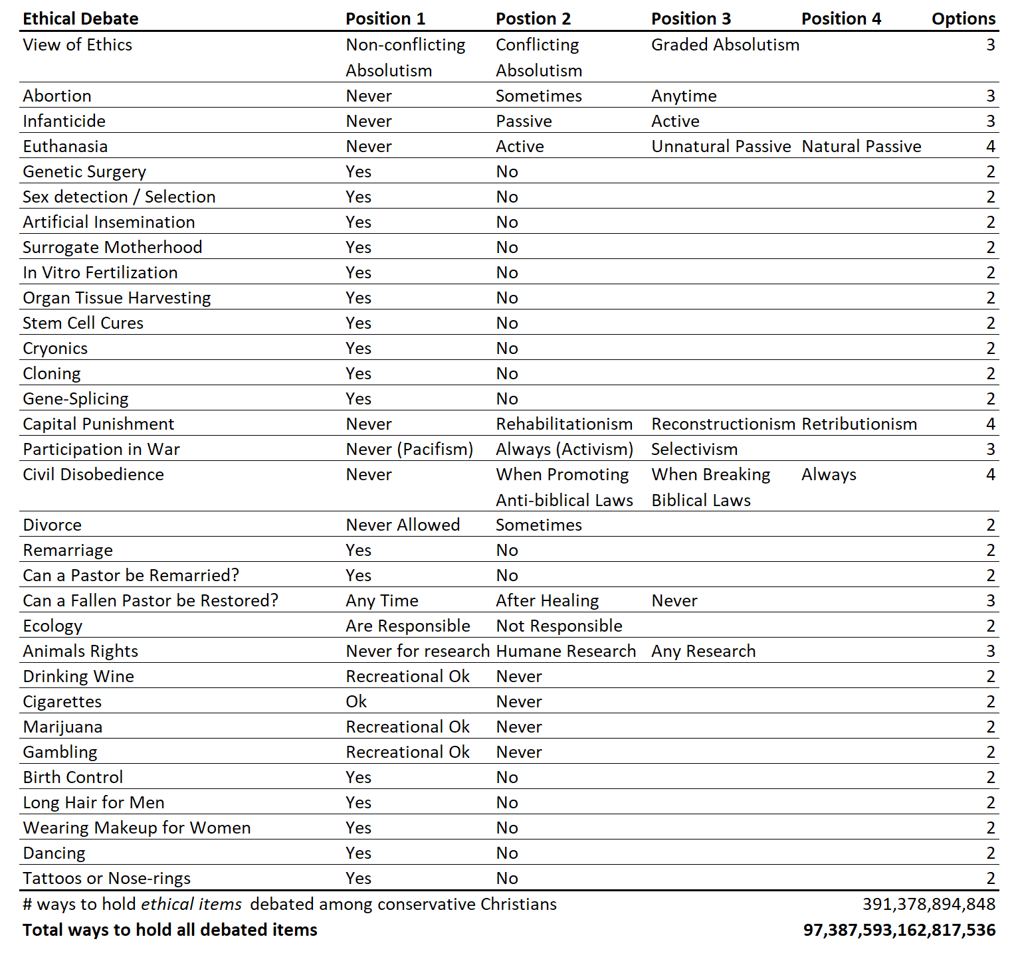
Now add in some ethical topics:
The odds somebody agrees with you on everything here:
1 in 97 quadrillion!

Slide 13
Important Safety Rails
in the Creation Debate
It’s important to:
1. Recognize the need for charity.
2. Value the Bible as special revelation.

Slide 14
2. The Bible as Special Revelation
Saying the Bible is the “Word of God” means it has 3 qualities:
Inspiration: Bible comes from God (it is breathed out by God; 2 Tim. 3:16-17).
Infallibility: Bible cannot fail (not one jot or tittle will disappear until all is fulfilled; Matt. 5:18).
Inerrancy: Bible is without error (Jn. 17:17; Psa. 19:7).
Challenge is not all hold to same level of inerrancy:
Full Inerrancy: Bible is without error in everything it speaks about including science and history (aka “a high-view of Scripture”).
Limited Inerrancy: Bible is accurate when it speaks about things pertaining to salvation, but not necessarily when speaking about history or science.

Slide 15
2. The Bible as Special Revelation (Cont’d)
A high-view of Scripture (full inerrancy) is an important safety rail because:
Full inerrancy was the historical position of the church.
Full inerrancy was the view of Jesus and the apostles (see next slides).

Slide 16
Jesus/Apostles Affirmed Accuracy of OT
1. Creation of the universe (Gen. 1) John 1:3; Col. 1:16
2. Creation of Adam and Eve (Gen. 1-2) 1 Tim. 2:13-14
3. Marriage of Adam and Eve (Gen. 1-2) 1 Tim. 2:13
4. Temptation of the woman (Gen. 3) 1 Tim. 2:14
5. Disobedience and sin of Adam (Gen. 3) Rom. 5:12; 1 Cor. 15:22
6. Sacrifices of Abel and Cain (Gen. 4) Heb. 11:4
7. Murder of Abel by Cain (Gen. 4) 1 John 3:12
8. Birth of Seth (Gen. 4) Luke 3:38
9. Translation of Enoch (Gen. 5) Heb. 11:5
10. Marriage before the flood (Gen. 6) Luke 17:27
11. The flood and destruction of man (Gen. 7) Matt. 24:39
12. Preservation of Noah and his family (Gen. 8-9) 2 Peter 2:5
13. Genealogy of Shem (Gen. 10) Luke 3:35-36
14. Birth of Abraham (Gen. 11) Luke 3:34
15. Call of Abraham (Gen. 12-13) Heb. 11:8
16. Tithes to Melchizedek (Gen. 14) Heb. 7:1-3

Slide 17
Jesus/Apostles Affirmed Accuracy of OT
17. Justification of Abraham (Gen. 15) Rom. 4:3
18. Ishmael (Gen. 16) Gal. 4:21-24
19. Promise of Isaac (Gen. 17) Heb. 11:18
20. Lot and Sodom (Gen. 18-19) Luke 17:29
21. Birth of Isaac (Gen. 21) Acts 7:9-10
22. Offering of Isaac (Gen. 22) Heb. 11:17
23. The burning bush (Ex. 3:6) Luke 20:32
24. Exodus through the Red Sea (Ex. 14:22) 1 Cor. 10:1-2
25. Provision of water and manna (Ex. 16:4; 17:6) 1 Cor. 10:3-5
26. Lifting up serpent in wilderness (Num. 21:9) John 3:14
27. Fall of Jericho (Joshua 6:22-25) Heb. 11:30
28. Miracles of Elijah (1 Kings 17:1; 18:1) Jas. 5:17
29. Jonah in the great fish (Jonah 2) Matt. 12:40
30. Three Hebrew youths in furnace (Dan. 3) Heb. 11:34
31. Daniel in lion’s den (Dan. 6) Heb. 11:33
32. Slaying of Zechariah (2 Chron. 24:20-22) Matt. 23:35

Slide 18
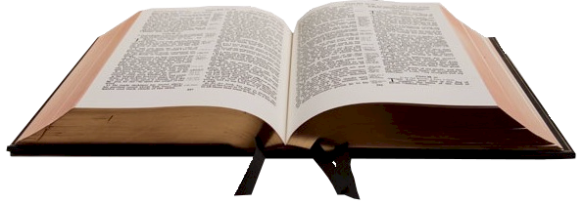
2. The Bible as Special Revelation (Cont’d)
A high-view of Scripture (full inerrancy) is an important safety rail because:
Full inerrancy was the historical position of the church.
Full inerrancy was the view of Jesus and the apostles.
Full inerrancy is the epistemological foundation of all other Christian doctrines.
Therefore, Christians should be very careful of accepting any view of creation that dehistoricizes biblical people and events.
Inspiration
Inerrancy
Infallibility

Slide 19
Problem
Inspiration
Inerrancy
Infallibility

Slide 20
The epistemological foundation of Christian faith crumbles!
Problem
!
Inspiration
Inerrancy
Infallibility

Slide 21
Important Safety Rails
in the Creation Debate
It’s important to:
1. Recognize the need for charity.
2. Value the Bible as special revelation.
3. Value science as general revelation.

Slide 22
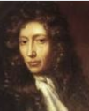
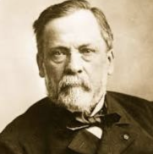
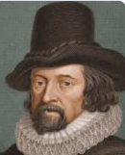
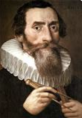
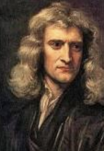
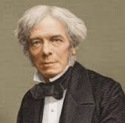
3. Value Science as General Revelation
Compatibility of science and Christianity
Modern science began inside a Christian worldview.
Many scientific pioneers were devout Christians
Francis Bacon (1561-1626)
Nicolaus Copernicus (1473-1543)
Johannes Kepler (1571-1630)
Galileo Galilei (1564-1642)
Isaac Newton (1643-1727)
Robert Boyle (1627-1691)
Michael Faraday (1791-1867)
Louis Pasteur (1822-1895)
6
1
2
8
4
3
5
7

Slide 23
3. Value Science as General Revelation (Cont’d)
Science as a means of discovery.
Mankind in God’s image means rational & capable of understanding the order found in the world.
Adam naming animals (Gen. 2:19-20) by identifying similarities and differences (i.e., genus and species).
Ability to observe nature implied in God-given mandate to take dominion of world (Gen. 1:28).
General revelation so clear it’s the basis mankind’s universal judgment (Rom. 1:20; 2:15).

Slide 24
3. Value Science as General Revelation (Cont’d)
Science as a means of biblical clarification
Reason and observation can also help clarify Scripture.
Joshua 10:12-14 - sun revolves around earth? Science clarifies: no! This is phenomenological.
Revelation 7:1 – earth has “four corners?” Science clarifies: No! This is metaphor.
Isa. 55:12 – Trees have hands that can clap? Science clarifies: No! This too is metaphor.
Therefore, valuing science is an important safety rail. If we climb over it, we may lose touch with reality and can find ourselves at risk of misunderstanding God’s intended meaning in Scripture.

Slide 25
Important Safety Rails
in the Creation Debate
It’s important to:
1. Recognize the need for charity.
2. Value the Bible as special revelation.
3. Value science as general revelation.
4. Acknowledge the limitations of science.

Slide 26
4. Acknowledge the Limitations of Science
Scientists play an active role.
Science not completely unbiased methodology.
“Instruments themselves do not measure… they require a mind.” (Wallace, 241)
Observation is more than just static “images cast upon the retinas” but is assimilated by a human mind that has been shaped by the “experience, knowledge and expectations of the observer.” (Chalmers, 7)
Problem of induction.
We can never prove something with absolute certainty with induction unless we have all relevant subjects in our reach of study. But how can we know?
Any conclusion we make will “invariably go beyond the finite amount of observable evidence that is available to support them” (Chalmers, 42).
Black Swan illustration.

Slide 27
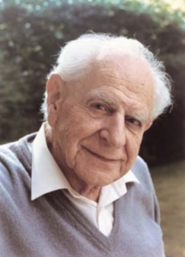
4. Acknowledge Limitations of Science (Cont’d)
People with workarounds to these problems…
Karl Popper (1902-1994)
Falsificationism: we can’t derive general scientific laws from a finite set of observable facts – but we can prove something is wrong!
“The falsity of a law can be logically deduced from a single observable fact with which it clashes.” (Chalmers, 81)
A theory that is not able to be falsified is not meaningful.
More falsifiable theories are preferred over less falsifiable ones.
A strong theory is one that is highly falsifiable yet is not falsified.

Slide 28
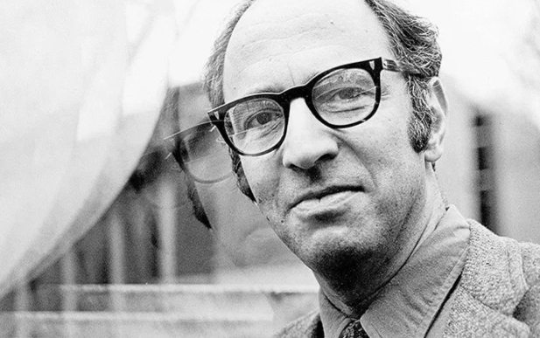
4. Acknowledge Limitations of Science (Cont’d)
People with workarounds to these problems…
Thomas Kuhn (1922-1996)
Scientists operate within frameworks (with bias).
History of science is movement through paradigm shifts.
Identifiable stages: (1) pre-science; (2) normal science; (3) crisis; (4) revolution; (5) new normal science; (6) new crisis; etc., to infinity.
“Normal science” is the currently accepted paradigm of the majority. There arises an anomaly; with enough anomalies comes period of insecurity. Some propose alternate theories that might be thought strange. When anomalies cannot be ignored any longer there’s a crisis and revolution. The new paradigm then becomes the norm. Repeat.
Scientific revolutions are like political revolutions, gestalt switches and even religious conversions.
Examples of revolutions: (1) Euclidean to Non-Euclidean geometry; (2) moving from an Aristotelian/Ptolemaic model of the universe to that of Copernicus; (3) from Newton’s concept of gravity to Einstein’s; and (4) from the Standard Model of physics to Quantum Mechanics.

Slide 29
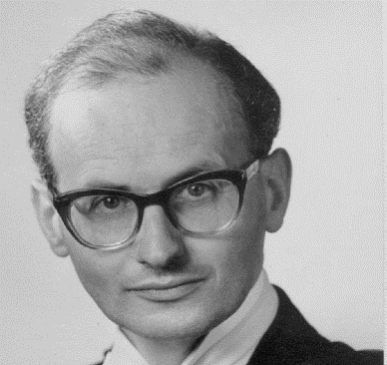
4. Acknowledge Limitations of Science (Cont’d)
People with workarounds to these problems…
Imre Lakatos (1922-1974)
Coined the phrase “research program.”
Said ok to ignore bias for reasonable time while working inside a research program.
Scientists should be allowed freedom to work for a time without worrying about whether their paradigm were literally true.
Hypothesis is considered the “hard core” of a program.
Additional hypothesis become the “protective belt.”
“Scientists are advised not to tinker with the hard core of the program in which they work. If a scientist does modify the hard core then he or she has, in effect, opted out of the program.” (Chalmers, 123)

Slide 30
4. Acknowledge Limitations of Science (Cont’d)
Conclusion
Should be clear from these points that science is not without bias and limitations.
It is fallible and needs to be viewed with a proper perspective.
If/when “science” & Scripture seem to clash, problem could be with scientific paradigm.

Slide 31
Important Safety Rails
in the Creation Debate
It’s important to:
1. Recognize the need for charity.
2. Value the Bible as special revelation.
3. Value science as general revelation.
4. Acknowledge the limitations of science.
5. Acknowledge a difference between the “Word of God” and interpretation.

Slide 32
5. Diff. between “Word of God” & Interpretation
Difference between “Word of God” and my interpretation.
“Word of God” = inspired, infallible and inerrant.
My interpretation could be wrong (i.e., is fallible).
“Inerrancy simply affirms that whatever the Bible affirms is true, but only hermeneutics can inform us as to what the Bible is actually affirming.” (Explaining Biblical Inerrancy, 10, emphasis mine)

Slide 33
5. “Word of God” & Interpretation (Cont’d)
Biblical Text vs. What the Bible is Affirming
Biblical Text | What Bible is Affirming
The Bible’s literary form. Some level of abstraction (we don’t have direct access to the mind of God but a text). Text tied to culture in history. Use of literary features (e.g., metaphors, hyperbole, idioms) Possible ambiguity as to which rule of grammar to follow. Because of abstraction and possible ambiguity, people can end up with different interpretations. | The Bible’s logical form. Author’s actual propositions (what is logically being predicated; same between human/divine author). Intended meaning of author (who encoded it and transmitted through rules of grammar in a language) discovered through hermeneutics. Inspired, infallible and inerrant special revelation. Will always correspond with reality (be true).

Slide 34
5. “Word of God” & Interpretation (Cont’d)
Degrees of probability.
Because of abstraction/ambiguity there is some level of uncertainty.
This is not saying that all doctrines are uncertain but not all doctrines are as certain as others (e.g., the secondary ones like creation); hence need for charity (Rom. 14).
When it goes too far.
There is freedom of interpretation in uncertain areas.
Bit this is not a license to take text beyond what rules of grammar allow (i.e., eisegesis).
ICBI said any attempts to dehistoricize people or events that Jesus and the NT biblical writers considered real events has gone too far—they have effectively climbed over an important safety rail.
With regard to the historicity of the Bible, Article XIII in the commentary points out that we should not “take Adam to be a myth, whereas in Scripture he is presented as a real person.” Likewise, it affirms that we should not “take Jonah to be an allegory when he is presented as a historical person and [is] so referred to by Christ.” (Explaining Biblical Inerrancy, 10.)

Slide 35
Important Safety Rails
in the Creation Debate
It’s important to:
1. Recognize the need for charity.
2. Value the Bible as special revelation.
3. Value science as general revelation.
4. Acknowledge the limitations of science.
5. Acknowledge a difference between the “Word of God” and interpretation.
6. Affirm teleology (purpose).

Slide 36
6. It’s Important to Affirm Teleology
A good Christian view of creation recognizes God as Creator, who created distinct things that operate toward a purpose.
God as Creator.
We should acknowledge God is an intentional Creator.
This touches on the area of teleology.
All creators (artists, architects, computer programmers, etc.) begin with ideas in the mind that are ordered to some desired end (teleos). These ideas are then brought into existence in some way by acting upon them in reality. In a similar way, God is a Creator.
God as Creator brought His ideas (form) into being by giving them existence.
Philosophically: these things are composed of matter and form (hylomorphism).

Slide 37
6. It’s Important to Affirm Teleology (Cont’d)
There’s a real world of distinct things.
Everything in the universe being not just matter but matter / idea is significant. It means that there are distinct things existing in the world.
“There is a real world, and that the things in it are all real in the sense that they are beings of one kind or another and their being is not a matter of opinion or conjecture.” (Oderberg, Real Essentialism, 18)
There’s teleology in nature (purpose).
These forms/ideas are not only distinct essences, but everything operates towards an end that God determined (teleos). Things happen intentionally.
Everything in creation functions within an order. Thus, they are directed towards an end and gave a purpose (they have final causality).
Teleology is also known as specified complexity and irreducible complexity.
Any Christian who flirts with a cosmogony that rests on purely a naturalistic or material causes has climbed over an important safety rail.

Slide 38
Important Safety Rails
in the Creation Debate
It’s important to:
1. Recognize the need for charity.
2. Value the Bible as special revelation.
3. Value science as general revelation.
4. Acknowledge the limitations of science.
5. Acknowledge a difference between the “Word of God” and interpretation.
6. Affirm teleology (purpose).
7. Acknowledge a difference between primary and secondary causes.

Slide 39
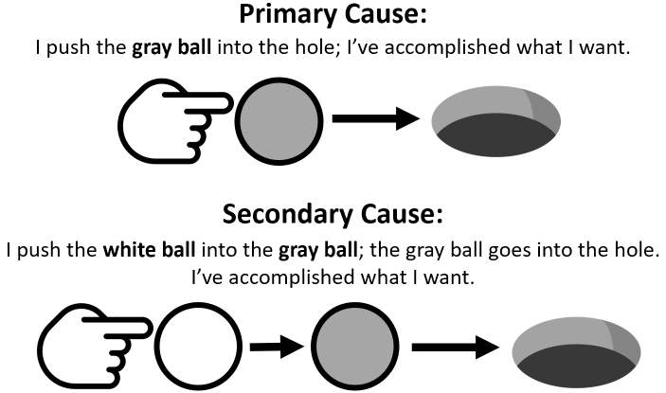
7. Diff. Between Primary & Secondary Causes
This last point shows why people disagreeing with theistic evolution should not label their theistic evolution friends as unbelieving heretics!
Theistic evolution is based on the idea that God is a primary cause who used evolution as a secondary cause for the origin of all things.
Logically speaking, if God used evolution, He would still rightly be called our Creator.
Here’s the difference between creation without and then with secondary causes:
Either way, God is in control.

Slide 40
Outline
Explain the 3 major views.
Give 7 safety rails.
Evaluate how each view lines up to these rails.

Slide 41
View | (1) Need For Charity | (2) High View of Scripture | (3) Natural Revelation | (4) Limitations of Science | (5) Bible vs. Interpretation | (6) Teleology | (7) Primary v. Sec. Causes | Note
A. Young Earth View | Very Weak | Very Strong | Weak | Very Strong | Weak | Strong | Weak | (A) tends to see anything but their view as attack on Scripture.
B. Old Earth, Non-Evolution | Strong | Strong* | Strong | Strong | Strong | Strong | Strong | (A) would say (B) is weak in (2).
C. Old Earth, Theistic Evolution | Strong | Weak* | Strong | Weak* | Strong | Weak* | Strong* | (C) Could be weak in (2) if dehistoricizing biblical people/events; Could be weak in (4) if uncritically accepting Darwinian theory. (C) seems to waiver in (6) & (7) at times veering into unguided evolution (D).
D. Atheistic Evolution | - | - | - | - | - | - | - | (D) included for comparison; if a (C) rejects (6) or (7) then they really hold this.
E. Intelligent Design | Strong* | n/c | Strong | Strong | n/c | Strong | Strong | (E) compatible with all views above except (D). (E) is strong in (1) in that appeals to Muslims, Jews, etc. (E) refrains from tying to any religion so it makes no comment regarding (2) and (5).

Slide 42
Important Safety Rails
in the Creation Debate
It’s important to:
1. Recognize the need for charity.
2. Value the Bible as special revelation.
3. Value science as general revelation.
4. Acknowledge the limitations of science.
5. Acknowledge a difference between the “Word of God” and interpretation.
6. Affirm teleology (purpose).
7. Acknowledge a difference between primary and secondary causes.

